Slide 1
-Plotting library for Python
-Works well with Numpy Syntax similar to Matlab -Pyplot: Most of the Matplotlib utilities lies under the pyplot submodule, and are usually imported under the plt alias:
What is Matplotlib?

Slide 2
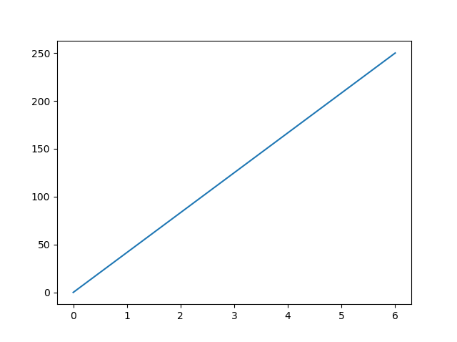
Plot X and Y points
import matplotlib.pyplot as plt import numpy as np xpoints = np.array([0, 6]) ypoints = np.array([0, 250]) plt.plot(xpoints, ypoints) plt.show()

Slide 3
Plot X and Y points
Exercise:
Draw a line in a diagram from position (1, 3) to position (8, 10):

Slide 4
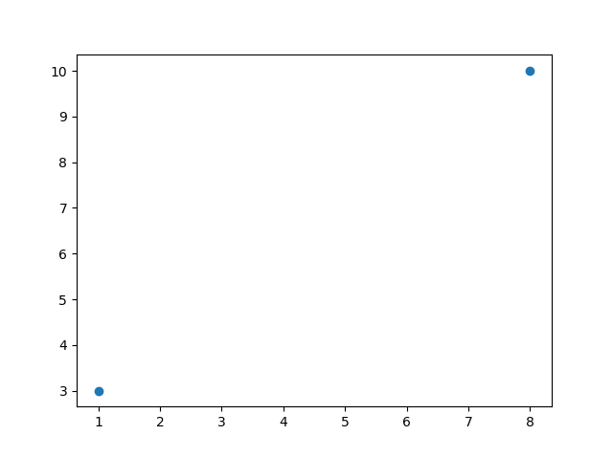
Plot without line To plot only the markers, you can use shortcut string notation parameter 'o', which means 'rings'
import matplotlib.pyplot as plt import numpy as np xpoints = np.array([1, 8]) ypoints = np.array([3, 10]) plt.plot(xpoints, ypoints, 'o') plt.show()

Slide 5
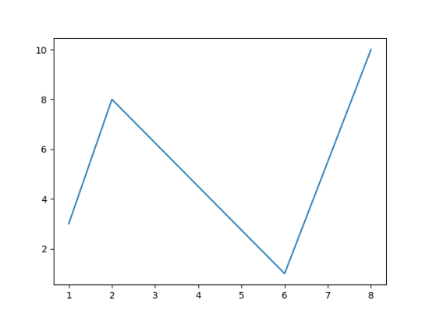
Plot Multiple points: Draw a line in a diagram from position (1, 3) to (2, 8) then to (6, 1) and finally to position (8, 10):
import matplotlib.pyplot as plt import numpy as np xpoints = np.array([1, 2, 6, 8]) ypoints = np.array([3, 8, 1, 10]) plt.plot(xpoints, ypoints) plt.show()

Slide 6
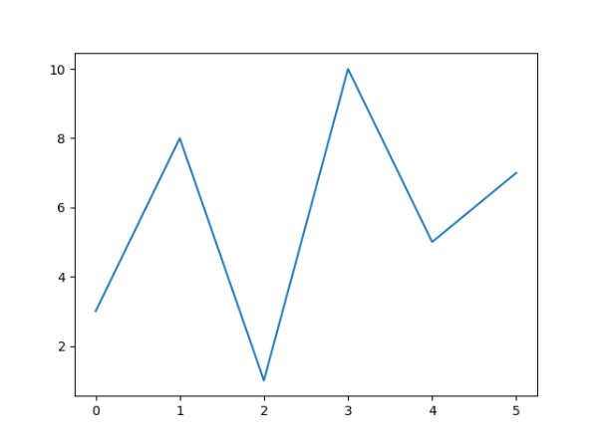
Default X-Points: If we do not specify the points in the x-axis, they will get the default values 0, 1, 2, 3, (etc. depending on the length of the y-points.
import matplotlib.pyplot as plt import numpy as np ypoints = np.array([3, 8, 1, 10, 5, 7]) plt.plot(ypoints) plt.show()

Slide 7
Default X-Points: If we do not specify the points in the x-axis, they will get the default values 0, 1, 2, 3, (etc. depending on the length of the y-points.
import matplotlib.pyplot as plt import numpy as np ypoints = np.array([3, 8, 1, 10, 5, 7]) plt.plot(ypoints) plt.show()

Slide 8
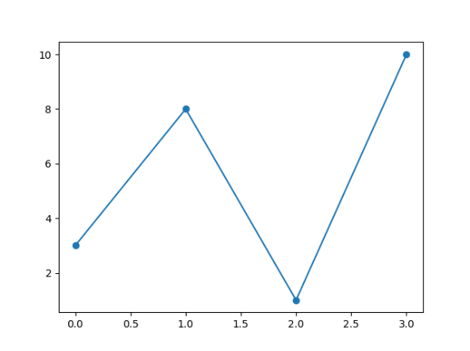
Markers: use the keyword argument marker to emphasize each point with a specified marker:
import matplotlib.pyplot as plt import numpy as np ypoints = np.array([3, 8, 1, 10]) plt.plot(ypoints, marker = 'o') plt.show()

Slide 9
Markers Reference:
Markers | Description
'o' | Circle
'*' | Star
'.' | Point
',' | Pixel
'x' | X
'X' | X (filled)
'+' | Plus
'P' | Plus (filled)
's' | Square
'D' | Diamond
'd' | Diamond (thin)
'p' | Pentagon
'H' | Hexagon
'h' | Hexagon
'v' | Triangle Down
'>' | Triangle Right
'1' | Tri Down
'2' | Tri Up
'3' | Tri Left

Slide 10
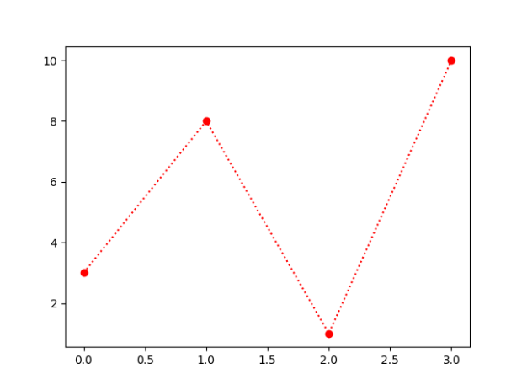
Format Strings fmt: This parameter is also called fmt, and is written with this syntax: marker|line|color
import matplotlib.pyplot as plt import numpy as np ypoints = np.array([3, 8, 1, 10]) plt.plot(ypoints, 'o:r') plt.show()
Line Syntax | Description
'-' | Solid line
':' | Dotted line
'--' | Dashed line
'-.' | Dashed/dotted line

Slide 11
Color Reference:
Color Syntax | Description
'r' | Red
'g' | Green
'b' | Blue
'c' | Cyan
'm' | Magenta
'y' | Yellow
'k' | Black
'w' | White

Slide 12
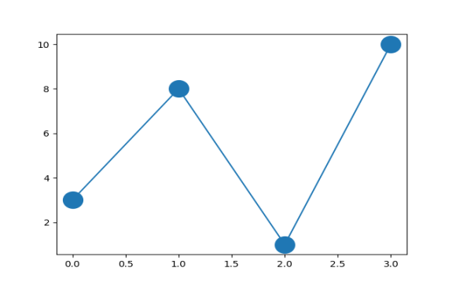
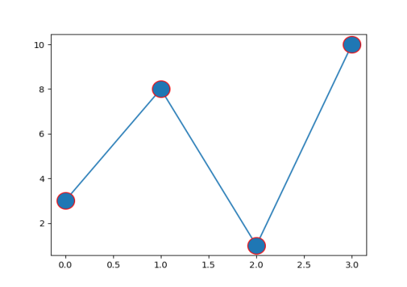
Marker Size: keyword argument markersize or the shorter version, ms to set the size of the markers: Marker Color: keyword argument markeredgecolor or the shorter mec to set the color of the edge of the markers:
import matplotlib.pyplot as plt import numpy as np ypoints = np.array([3, 8, 1, 10]) plt.plot(ypoints, marker = 'o', ms = 20, mec=‘r’)
#plt.plot(ypoints, marker = 'o', ms = 20) plt.show()

Slide 13
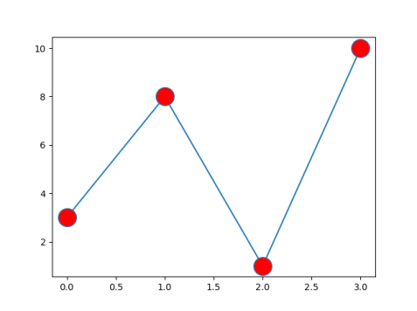
Marker Size: keyword argument markersize or the shorter version, ms to set the size of the markers. Markerfacecolor or the shorter mfc to set the color inside the edge of the markers
import matplotlib.pyplot as plt import numpy as np ypoints = np.array([3, 8, 1, 10]) plt.plot(ypoints, marker = 'o', ms = 20, mec=‘r’)
#plt.plot(ypoints, marker = 'o', ms = 20, mfc = 'r')
plt.show()

Slide 14
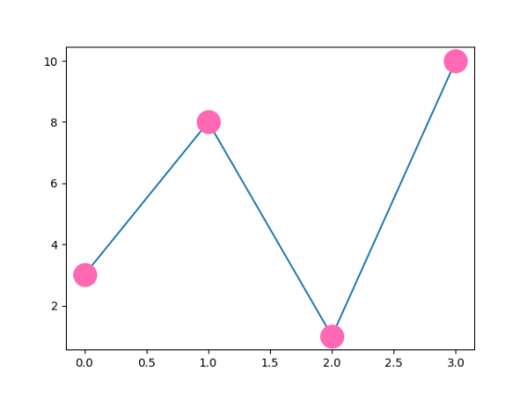
Marker Size: keyword argument markersize or the shorter version, ms to set the size of the markers. Markerfacecolor or the shorter mfc to set the color inside the edge of the markers. Markeredgecolor to set edge color
import matplotlib.pyplot as plt import numpy as np ypoints = np.array([3, 8, 1, 10]) plt.plot(ypoints, marker = 'o', ms = 20, mec = 'hotpink', mfc = 'hotpink')
plt.show()

Slide 15
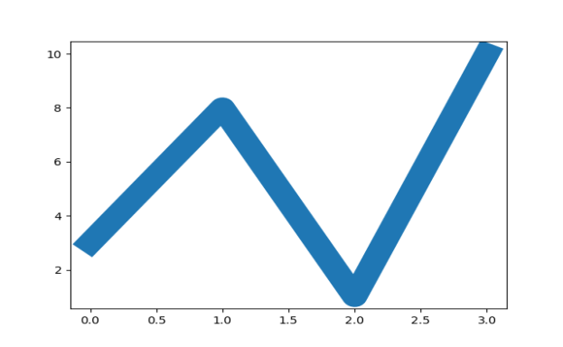
Matplotlib Line --keyword argument linestyle, or shorter ls, to change the style of the plotted line -- dotted can be written as : dashed can be written as -- -- keyword argument color or the shorter c to set the color of the line -- keyword argument linewidth or the shorter lw to change the width of the line
import matplotlib.pyplot as plt import numpy as np ypoints = np.array([3, 8, 1, 10]) plt.plot(ypoints, linewidth = '20.5')
#plt.plot(ypoints, ls=‘dotted’, c=‘r’) plt.show()

Slide 16
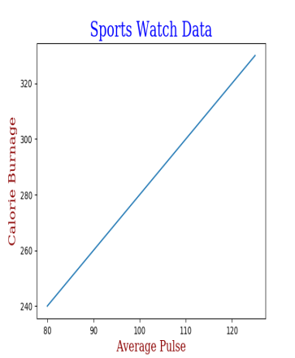
Create Labels for a Plot --With Pyplot, the xlabel() and ylabel() functions to set a label for the x and y-axis. --With Pyplot, you can use the title() function to set a title for the plot. -- Use the loc parameter in title() to position the title. Legal values are: 'left', 'right', and 'center'. Default value is 'center'.
import numpy as np import matplotlib.pyplot as plt x = np.array([80, 85, 90, 95, 100, 105, 110, 115, 120, 125]) y = np.array([240, 250, 260, 270, 280, 290, 300, 310, 320, 330]) font1 = {'family':'serif','color':'blue','size':20} font2 = {'family':'serif','color':'darkred','size':15}
plt.xlabel("Average Pulse", fontdict = font2) plt.title("Sports Watch Data", fontdict = font1, loc=‘center’) plt.ylabel("Calorie Burnage", fontdict = font2) plt.plot(x, y) plt.show()

Slide 17
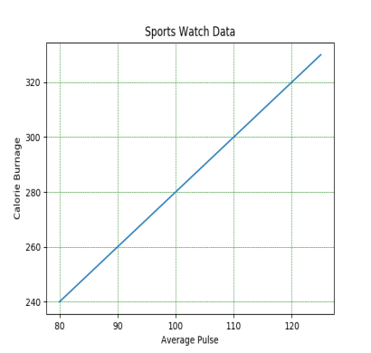
Grid Lines to a Plot --use the grid() function to add grid lines to the plot. --line properties of the grid, like this: grid(color = 'color', linestyle = 'linestyle', linewidth = number). -- Use the loc parameter in title() to position the title. Legal values are: 'left', 'right', and 'center'. Default value is 'center'.
import numpy as np import matplotlib.pyplot as plt x = np.array([80, 85, 90, 95, 100, 105, 110, 115, 120, 125]) y = np.array([240, 250, 260, 270, 280, 290, 300, 310, 320, 330]) plt.title("Sports Watch Data") plt.xlabel("Average Pulse") plt.ylabel("Calorie Burnage") plt.plot(x, y) plt.grid(color = 'green', linestyle = '--', linewidth = 0.5) plt.show()

Slide 18
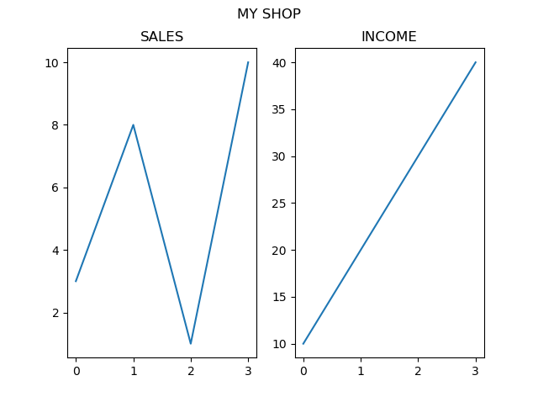
Display Multiple plots using Subplot --The subplot() function takes three arguments that describes the layout of the figure. The layout is organized in rows and columns, which are represented by he first and second argument. The third argument represents the index of the current plot. --add a title to each plot with the title() function -- add a title to the entire figure with the suptitle() function:
import matplotlib.pyplot as plt import numpy as np #plot 1: x = np.array([0, 1, 2, 3]) y = np.array([3, 8, 1, 10]) plt.subplot(1, 2, 1) plt.plot(x,y) plt.title("SALES") #plot 2: x = np.array([0, 1, 2, 3]) y = np.array([10, 20, 30, 40]) plt.subplot(1, 2, 2) plt.plot(x,y) plt.title("INCOME") plt.suptitle("MY SHOP") plt.show()

Slide 19
Display Multiple plots using Subplot --The subplot() function takes three arguments that describes the layout of the figure. The layout is organized in rows and columns, which are represented by he first and second argument. The third argument represents the index of the current plot. --add a title to each plot with the title() function -- add a title to the entire figure with the suptitle() function:
import matplotlib.pyplot as plt import numpy as np #plot 1: x = np.array([0, 1, 2, 3]) y = np.array([3, 8, 1, 10]) plt.subplot(1, 2, 1) plt.plot(x,y) plt.title("SALES") #plot 2: x = np.array([0, 1, 2, 3]) y = np.array([10, 20, 30, 40]) plt.subplot(1, 2, 2) plt.plot(x,y) plt.title("INCOME") plt.suptitle("MY SHOP") plt.show()

Slide 20
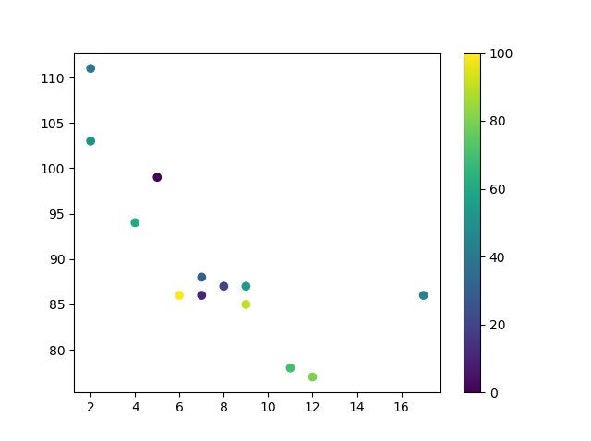
Creating Scatter Plots
import matplotlib.pyplot as plt import numpy as np x = np.array([5,7,8,7,2,17,2,9,4,11,12,9,6]) y = np.array([99,86,87,88,111,86,103,87,94,78,77,85,86]) colors = np.array([0, 10, 20, 30, 40, 45, 50, 55, 60, 70, 80, 90, 100]) plt.scatter(x, y, c=colors, cmap='viridis') plt.colorbar() plt.show()

Slide 21
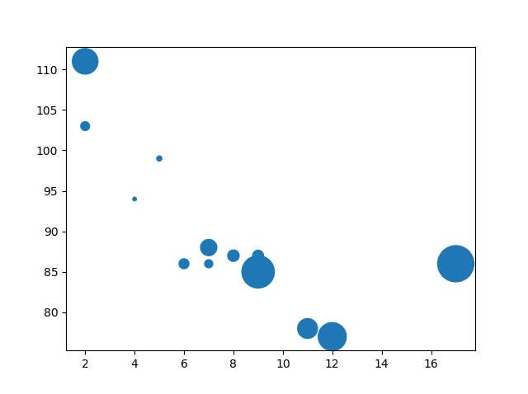
Creating Scatter Plots
import matplotlib.pyplot as plt import numpy as np x = np.array([5,7,8,7,2,17,2,9,4,11,12,9,6]) y = np.array([99,86,87,88,111,86,103,87,94,78,77,85,86]) sizes = np.array([20,50,100,200,500,1000,60,90,10,300,600,800,75]) plt.scatter(x, y, s=sizes) plt.show()

Slide 22
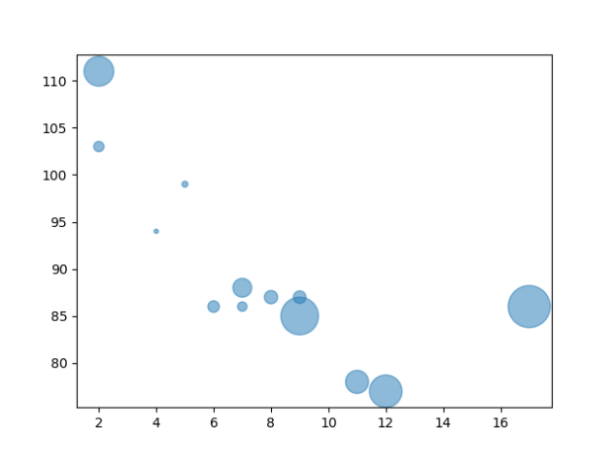
Creating Scatter Plots
import matplotlib.pyplot as plt import numpy as np x = np.array([5,7,8,7,2,17,2,9,4,11,12,9,6]) y = np.array([99,86,87,88,111,86,103,87,94,78,77,85,86]) sizes = np.array([20,50,100,200,500,1000,60,90,10,300,600,800,75]) plt.scatter(x, y, s=sizes, alpha=0.5) plt.show()

Slide 23
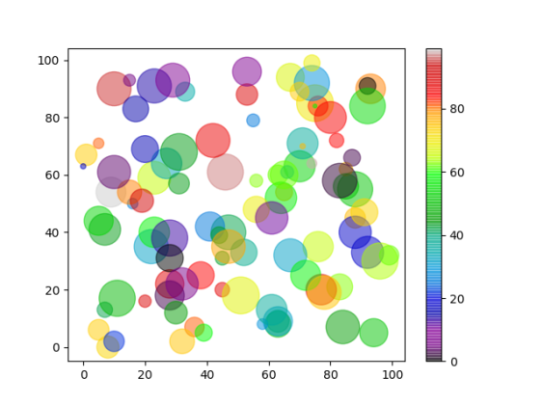
Creating Scatter Plots
import matplotlib.pyplot as plt import numpy as np x = np.random.randint(100, size=(100)) y = np.random.randint(100, size=(100)) colors = np.random.randint(100, size=(100)) sizes = 10 * np.random.randint(100, size=(100)) plt.scatter(x, y, c=colors, s=sizes, alpha=0.5, cmap='nipy_spectral') plt.colorbar() plt.show()

Slide 24
Creating Scatter Plots
import matplotlib.pyplot as plt import numpy as np x = np.random.randint(100, size=(100)) y = np.random.randint(100, size=(100)) colors = np.random.randint(100, size=(100)) sizes = 10 * np.random.randint(100, size=(100)) plt.scatter(x, y, c=colors, s=sizes, alpha=0.5, cmap='nipy_spectral') plt.colorbar() plt.show()

Slide 25
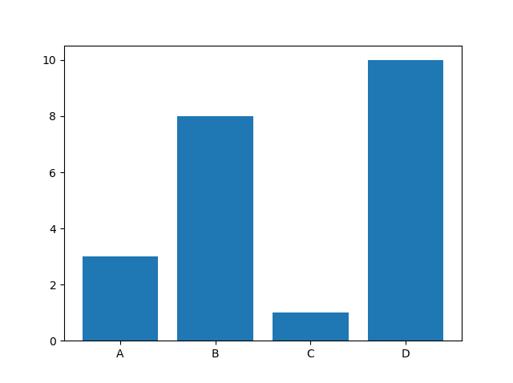
Scatter Plot
Creating Bars: With Pyplot, use the bar() function to draw bar graphs:
import matplotlib.pyplot as plt import numpy as np x = np.array(["A", "B", "C", "D"]) y = np.array([3, 8, 1, 10]) plt.bar(x,y) plt.show()

Slide 26
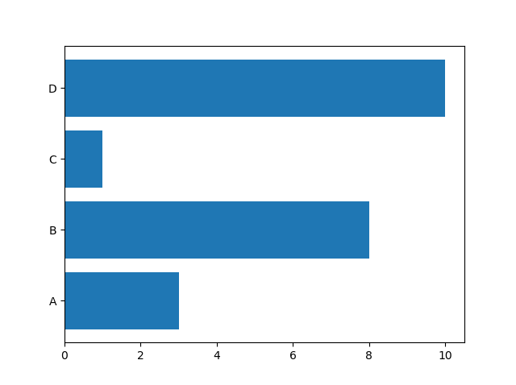
Scatter Plot
Creating Bars: With Pyplot, use the barh() function to draw bar graphs:
import matplotlib.pyplot as plt import numpy as np x = np.array(["A", "B", "C", "D"]) y = np.array([3, 8, 1, 10]) plt.barh(x, y) plt.show()

Slide 27
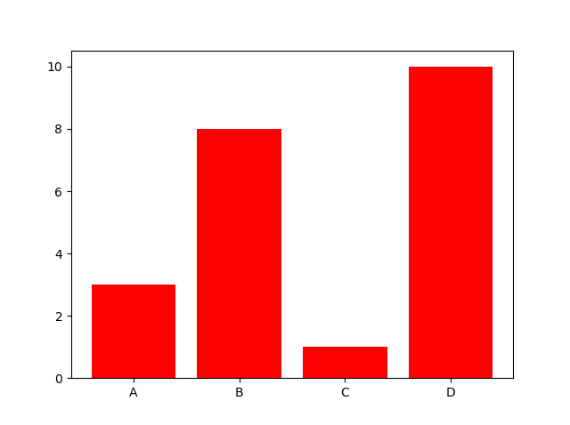
Scatter Plot
Creating Bars: With Pyplot, use the bar() function to draw bar graphs:
import matplotlib.pyplot as plt import numpy as np x = np.array(["A", "B", "C", "D"]) y = np.array([3, 8, 1, 10]) plt.bar(x, y, color = "red") plt.show()

Slide 28
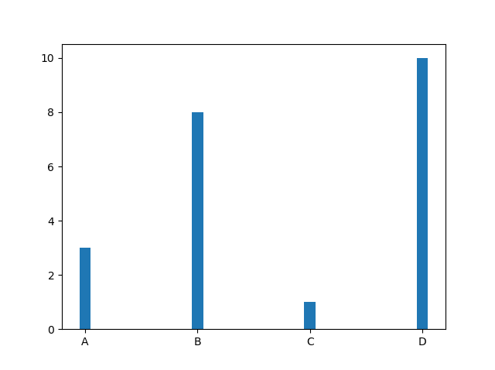
Scatter Plot
Creating Bars: With Pyplot, use the bar() function to draw bar graphs:
import matplotlib.pyplot as plt import numpy as np x = np.array(["A", "B", "C", "D"]) y = np.array([3, 8, 1, 10]) plt.bar(x, y, width = 0.1) plt.show()

Slide 29
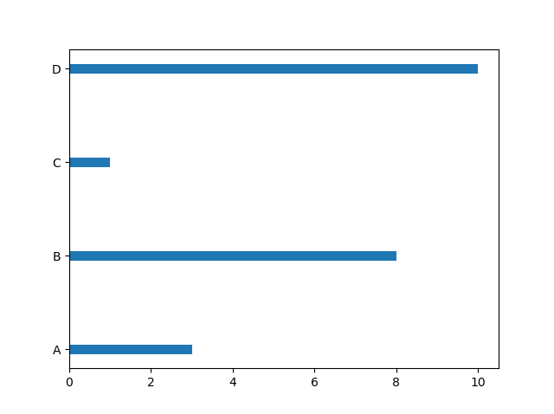
Scatter Plot
Creating Bars: With Pyplot, use the barh() function to draw bar graphs:
import matplotlib.pyplot as plt import numpy as np x = np.array(["A", "B", "C", "D"]) y = np.array([3, 8, 1, 10]) plt.barh(x, y, height = 0.1) plt.show()

Slide 30
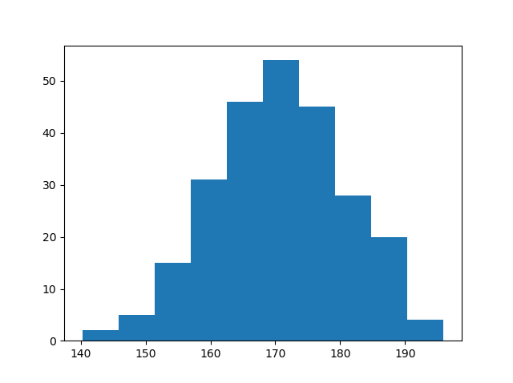
Scatter Plot
Create Histogram
In Matplotlib, we use the hist() function to create histograms.
The hist() function will use an array of numbers to create a histogram,
For simplicity we use NumPy to randomly generate an array with 250 values, where the values will concentrate around 170, and the standard deviation is 10.
Creating Bars: With Pyplot, use the barh() function to draw bar graphs:
import matplotlib.pyplot as plt import matplotlib.pyplot as plt import numpy as np x = np.random.normal(170, 10, 250) plt.hist(x) plt.show()

Slide 31
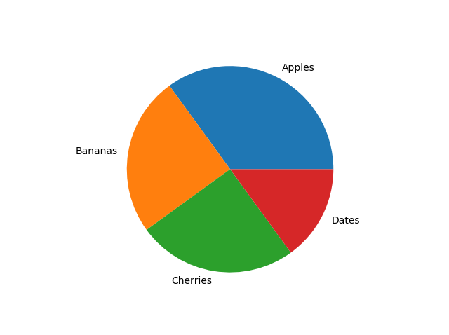
Creating Pie Charts
With Pyplot, use the pie() function to draw pie charts:
import matplotlib.pyplot as plt import numpy as np y = np.array([35, 25, 25, 15]) mylabels = ["Apples", "Bananas", "Cherries", "Dates"] plt.pie(y, labels = mylabels) plt.show()

Slide 32
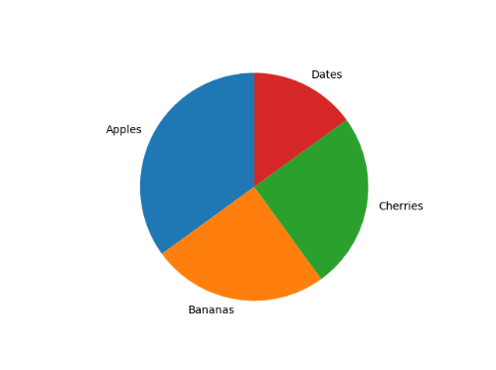
Creating Pie Charts
With Pyplot, use the pie() function to draw pie charts, start first wedge at 90 degree angle:
import matplotlib.pyplot as plt import numpy as np y = np.array([35, 25, 25, 15]) mylabels = ["Apples", "Bananas", "Cherries", "Dates"] plt.pie(y, labels = mylabels, startangle = 90) plt.show()

Slide 33
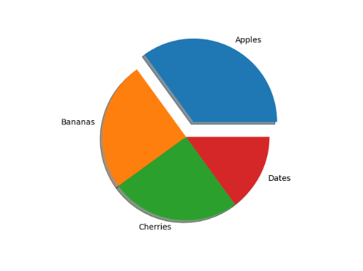
Creating Pie Charts
With Pyplot, use the pie() function to draw pie charts.
import matplotlib.pyplot as plt import numpy as np y = np.array([35, 25, 25, 15]) mylabels = ["Apples", "Bananas", "Cherries", "Dates"] myexplode = [0.2, 0, 0, 0] plt.pie(y, labels = mylabels, explode = myexplode, shadow = True) plt.show()

Slide 34
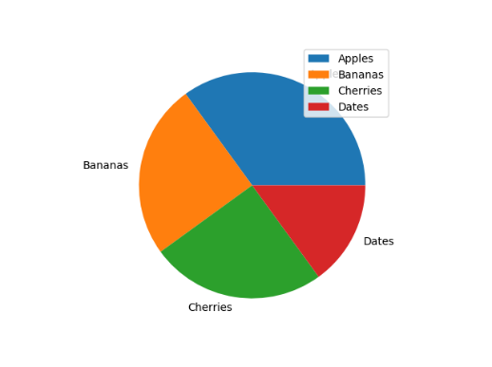
Creating Pie Charts
With Pyplot, use the pie() function to draw pie charts.
import matplotlib.pyplot as plt import numpy as np y = np.array([35, 25, 25, 15]) mylabels = ["Apples", "Bananas", "Cherries", "Dates"] plt.pie(y, labels = mylabels) plt.legend() plt.show()

Slide 35
Box Plot
samp1 = np.random.normal(loc=0., scale=1., size=100) samp2 = np.random.normal(loc=1., scale=2., size=100) samp3 = np.random.normal(loc=0.3, scale=1.2, size=100)
f, ax = plt.subplots(1, 1, figsize=(5,4))
ax.boxplot((samp1, samp2, samp3)) ax.set_xticklabels([’sample 1’, ’sample 2’, ’sample 3’]) plt.savefig(’boxplot.pdf’)

Slide 36
Box Plot
6
4
2
0
−2
−4
sample 1
sample 2
sample 3

Slide 37
Image Plot
A = np.random.random((100, 100)) plt.imshow(A)
plt.hot()
plt.colorbar()
plt.savefig(’imageplot.pdf’)

Slide 38
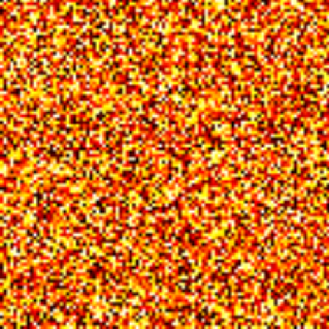
Image Plot
0
1.0
0.9
20
0.8
0.7
40
0.6
0.5
60
0.4
0.3
80
0.2
0.1
0.0
0
20
40
60
80

Slide 39
Wire Plot
matplotlib toolkits extend funtionality for other kinds of visualization
from mpl_toolkits.mplot3d import axes3d
ax = plt.subplot(111, projection=’3d’) X, Y, Z = axes3d.get_test_data(0.1)
ax.plot_wireframe(X, Y, Z, linewidth=0.1)
plt.savefig(’wire.pdf’)

Slide 40
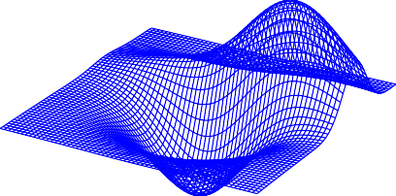
Wire Plot
100
80
60
40
20
0
−20
−40
−60
−80
30
20
10
0
−30
−20
−10 ₀
−10
10 ₂₀
−20
₃₀−30

